Slide 1


URBAN DEVELOPMENT DIRECTORATE (UDD)
GOVERNMENT OF THE PEOPLE’S REPUBLIC OF BANGLADESH
Presentation On
Draft Final Report
Geological Study And Seismic Hazard Assessment
Under
Preparation of Development Plan for Mirsharai Upazila, Chittagong District: Risk Sensitive Landuse Plan (MUDP)
Package No. 2 (Two)
Presented By
Nasim Ferdous
Geologist & Team Leader
Environmental & Geospatial Solutions (EGS)

Slide 2
INTRODUCTION
To ensure the sustainable development, the prime objectives of this work is to determine subsurface soil condition of the project area and evaluating of natural geological and hydro-meteorological hazards such as earthquake, landslide and integrate the consequence into the design of the infrastructure.

Slide 3
Aims and Objectives
Geological and geomorphologic map of the study area
Sub-surface lithological 3D model development
Soil classification map using geophysical and geotechnical investigations
Engineering geological map development based on AVS30
Foundation layers delineation and developing engineering properties of the sub-soil
Seismic Hazard Mapping [ PGA, Sa (T) Maps of 0.2 and 1.0 second periods]
Risk Sensitive Building Height
Landslide vulnerable zones will be identified
Liquefaction potential index (LPI) map will be constructed
Formulation of Policies and plans for mitigation of different types of hazards, minimizing the adverse impacts of climate change and recommend possible adaptation strategies for the region.

Slide 4
METHODOLOGY
To accomplish this study two types of Investigation need have been performed;
Geotechnical Investigation
Geophysical Investigation
Name of Union | Name of investigations
 | Borelog with SPT ( upto 30m) | PS logging (30m depth) | MASW (30m depth) | Single Microtremor
Ichhakhali, Wahedpur, Osmanpur, Karerhat, Katachhara, Khaiyachhara, Zorwarganj, Durgapur, Dhum, Maghadia, Mayani, Mithanala, Mirsharai, Saherkhali, Haitkandi and Hinguli | 85 | 15 | 20 | 30

Slide 5
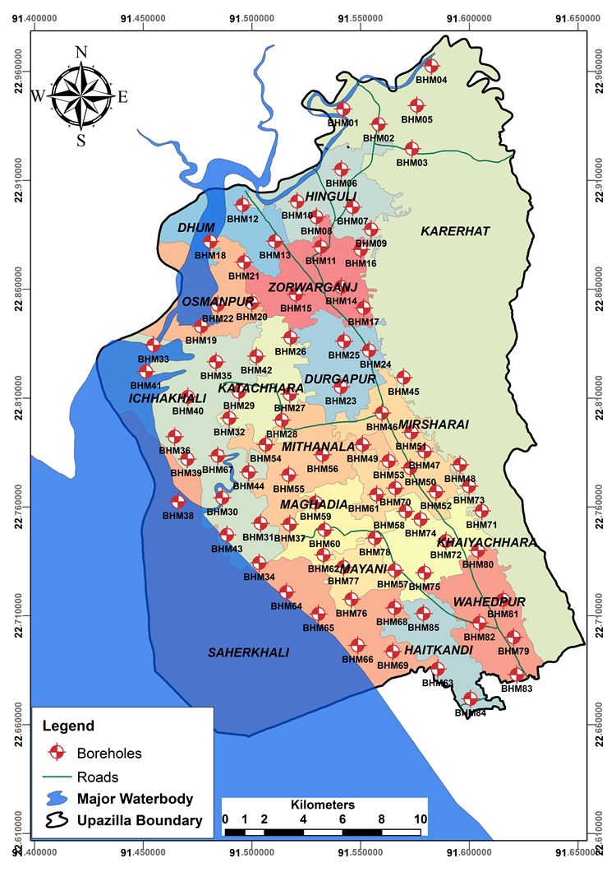
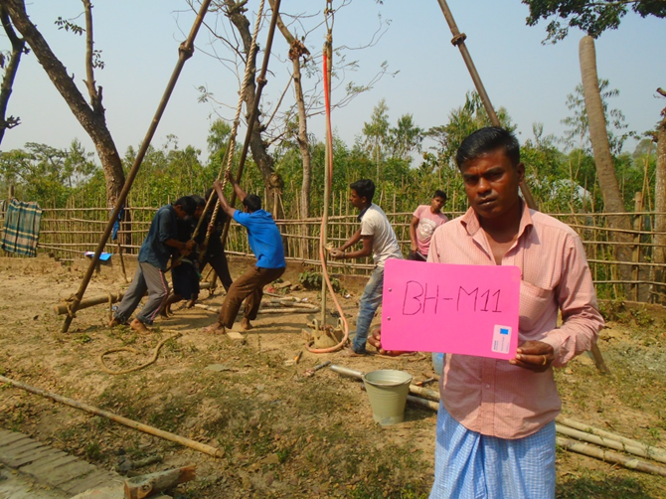
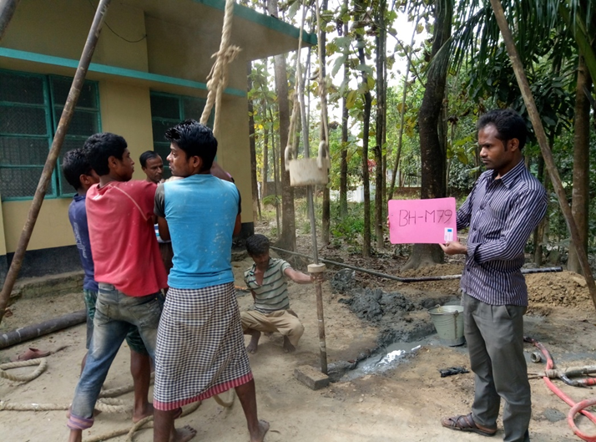
Standard Penetration Test

Slide 6
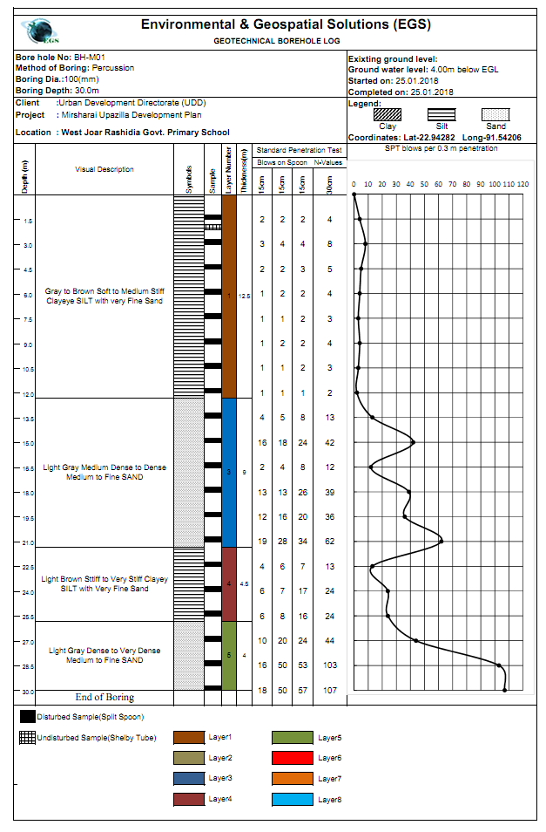
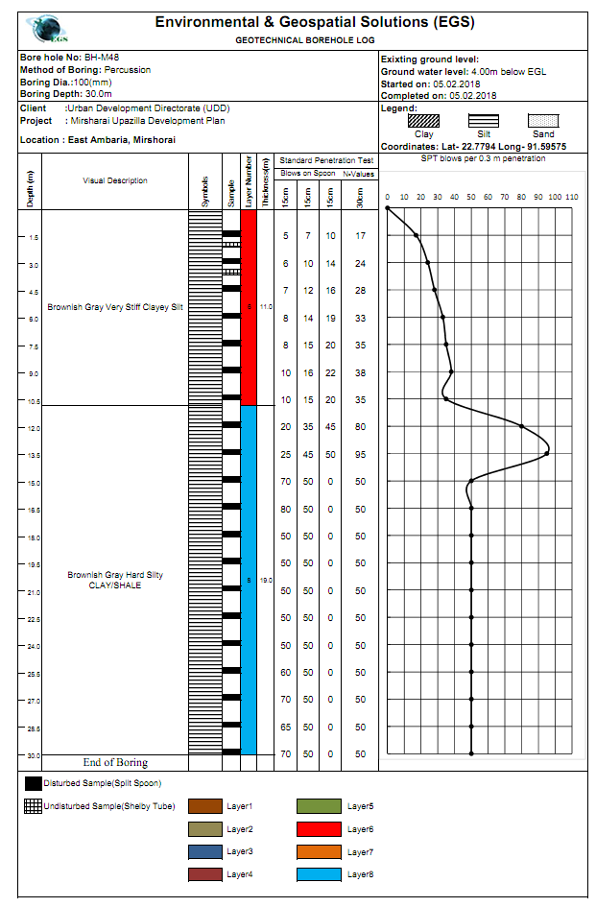
SPT Bore Log

Slide 7
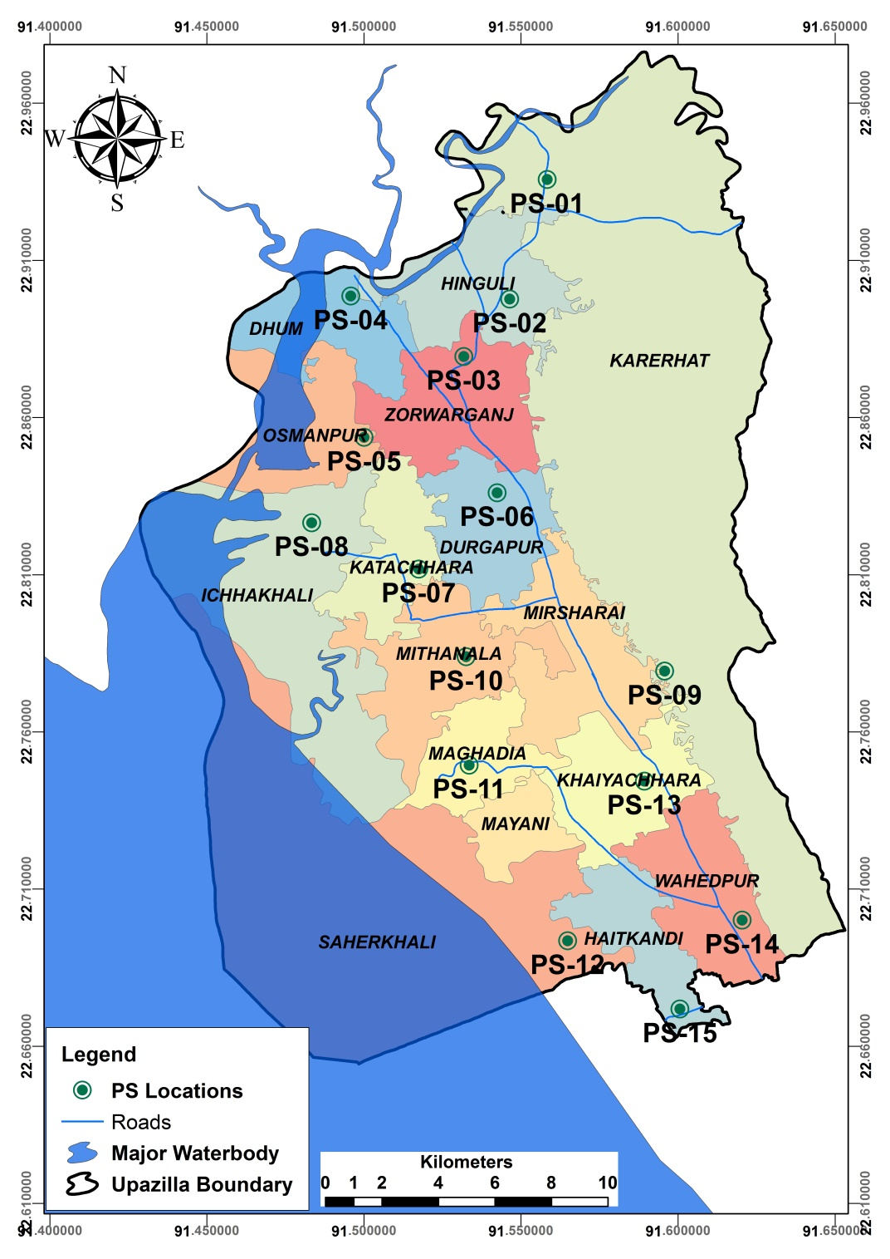
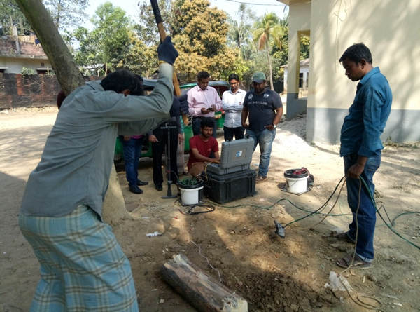
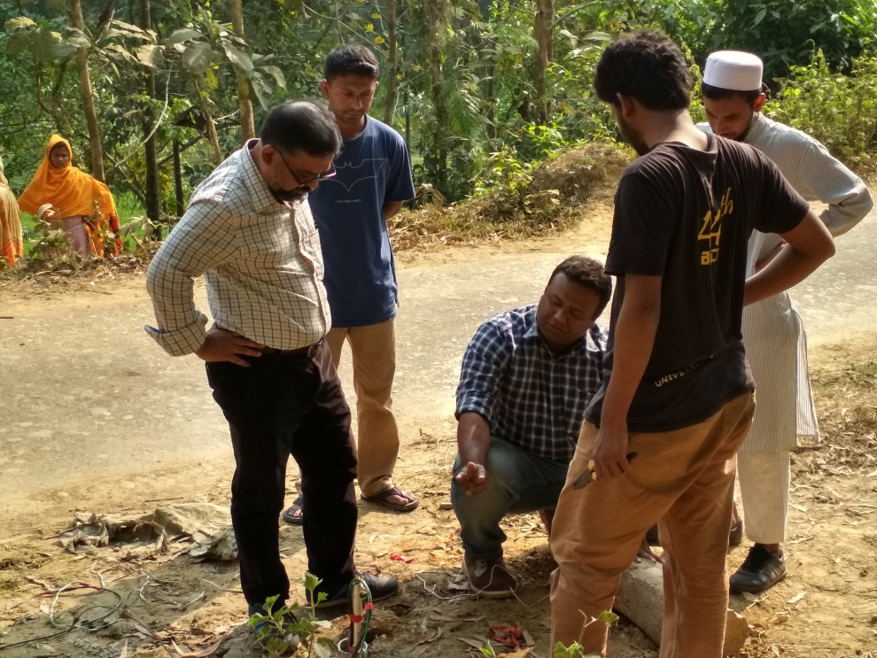
PS Logging Test
Khil hinguli Govt. Primary School
East Ambaria, Mirshorai

Slide 8
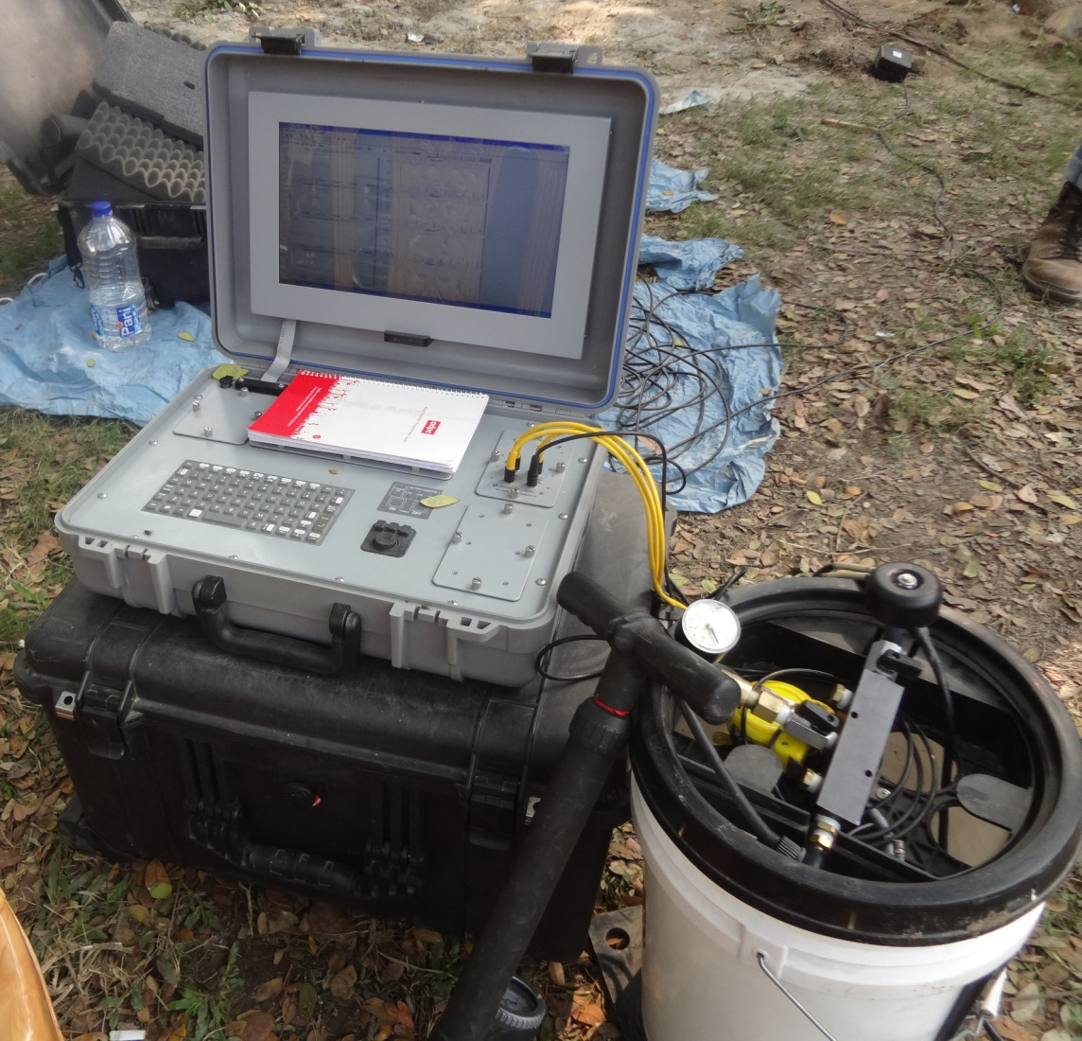
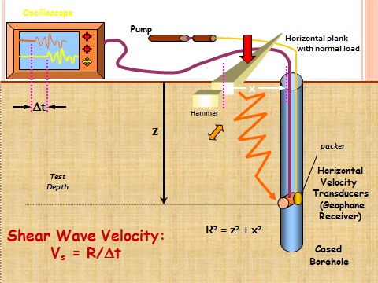
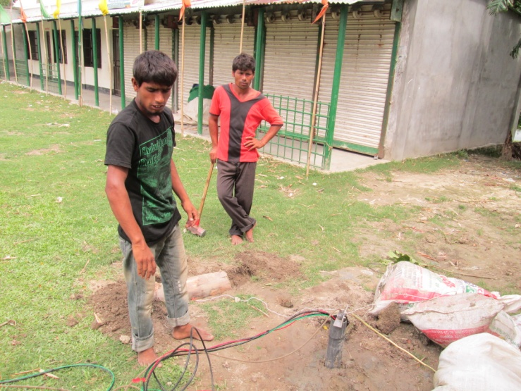
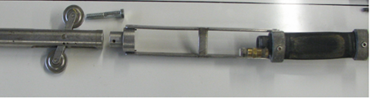
PS Logging Test
Borehole
1m

Slide 9
PS Logging Data Output
180 m/s
180 m/s

Slide 10
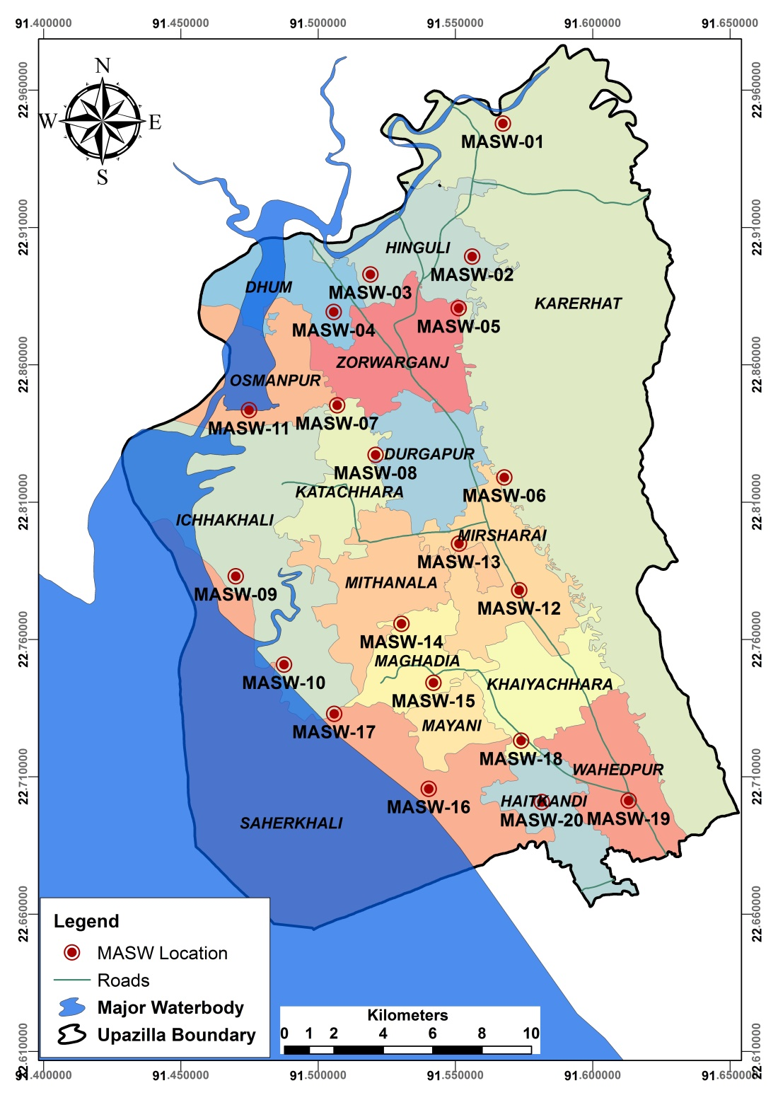
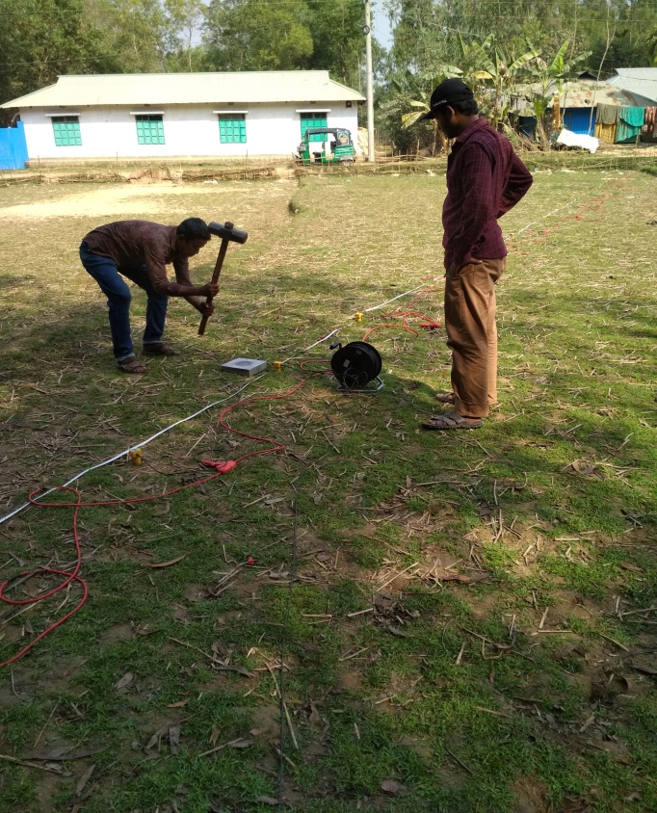

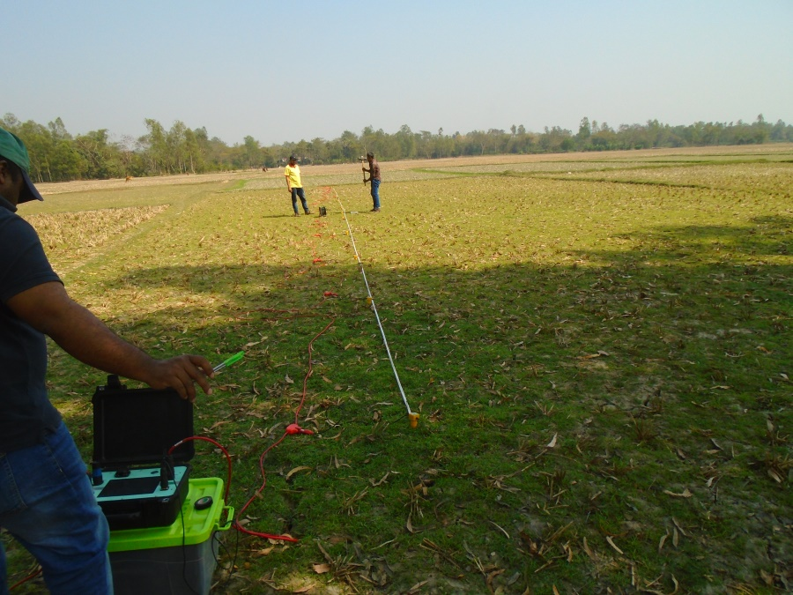
Multi Channel Analysis of Surface Wave (MASW)
MASW-20 (Monir hut, East Hait Kandi)

Slide 11
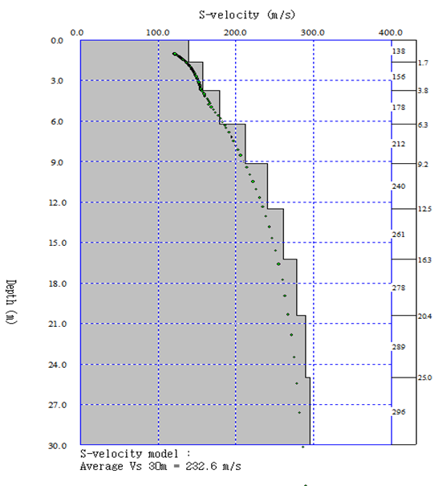
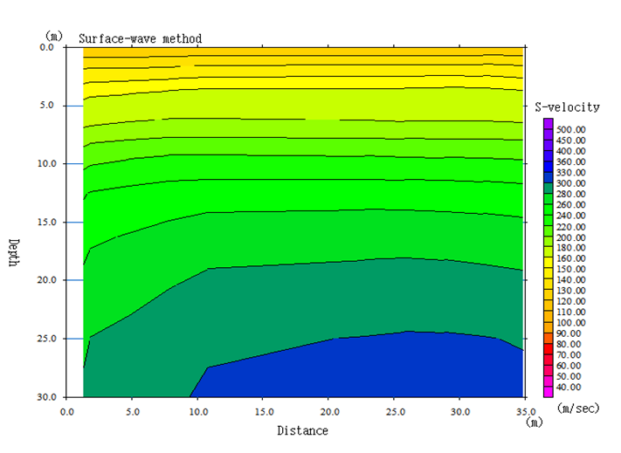
Multi Channel Analysis of Surface Wave (MASW) Data Output
Depth vs S-Wave Velocity 1D and 2D

Slide 12

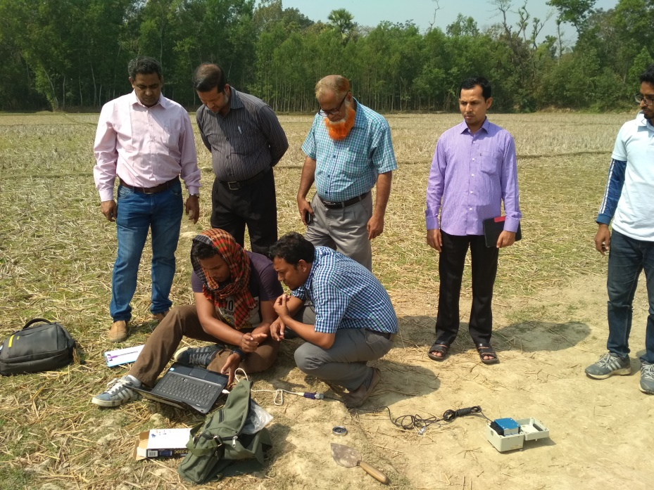
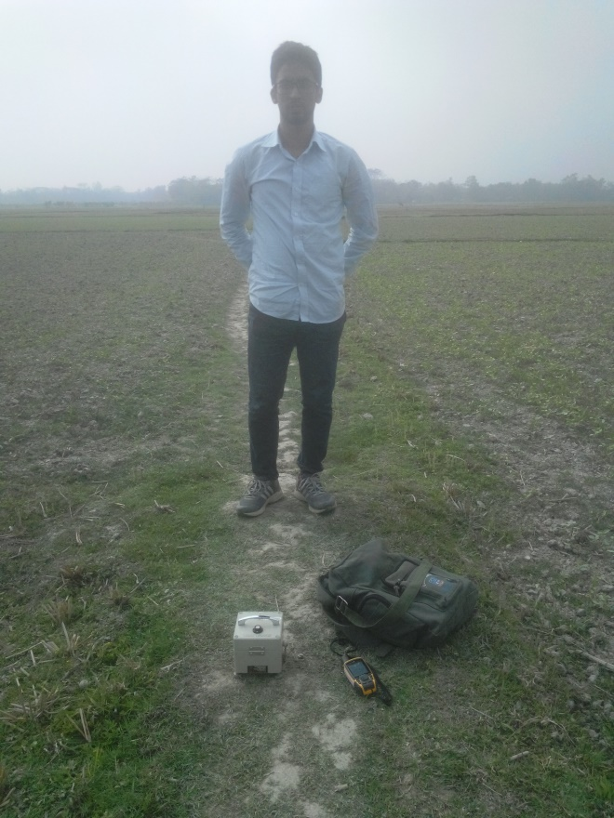
Single Microtremor Test
West Olinagar,
Karerhat
Uttar bogachotor, Saherkhali

Slide 13
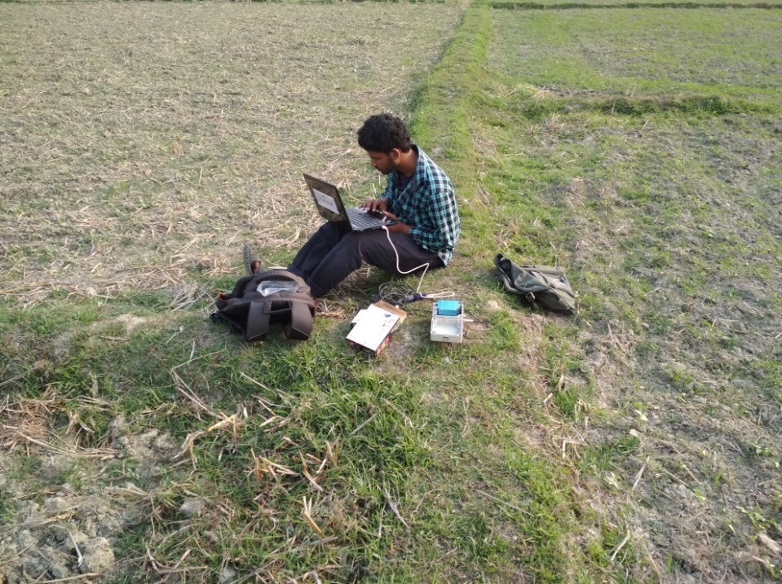
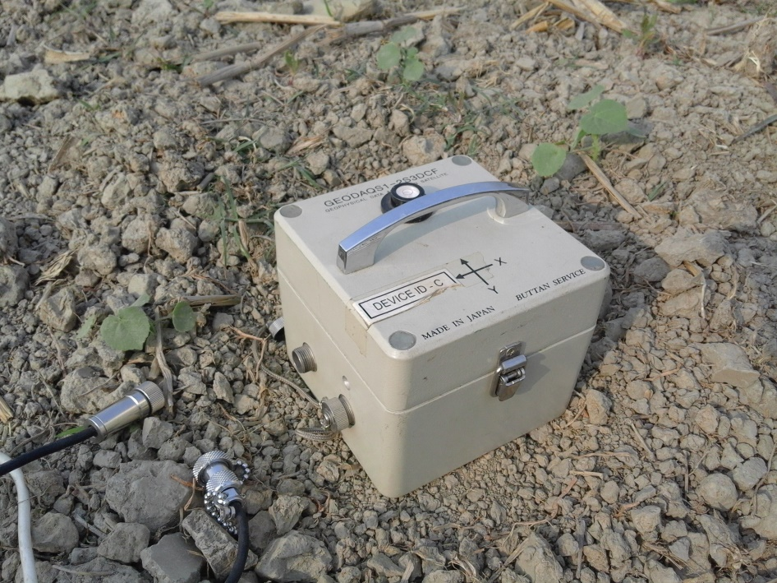
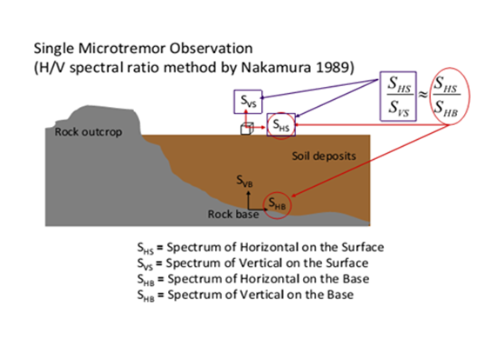
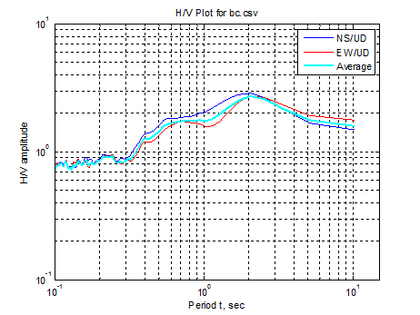
Single Microtremor Test
MT-04
Location: Ichakhai
2.0 sec

Slide 14
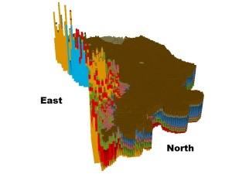
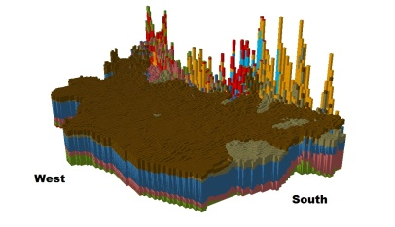
Subsurface lithological 3D model

Slide 15
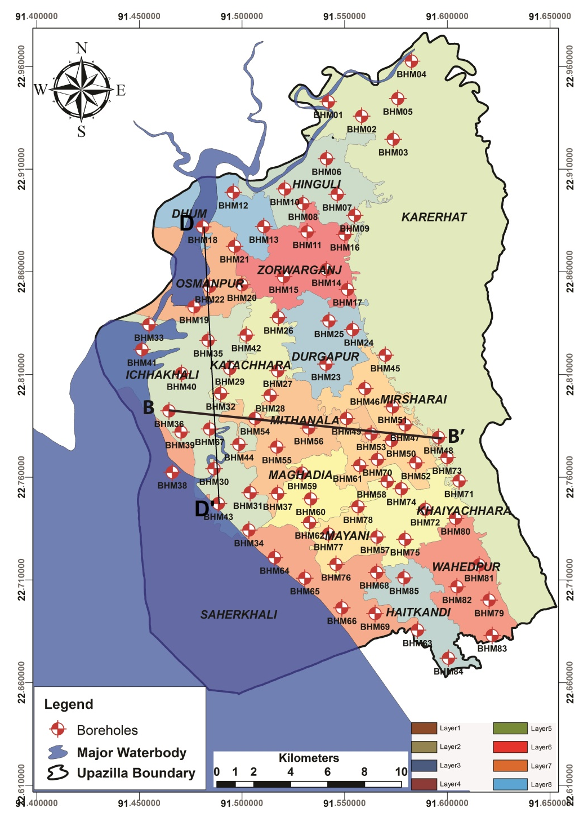
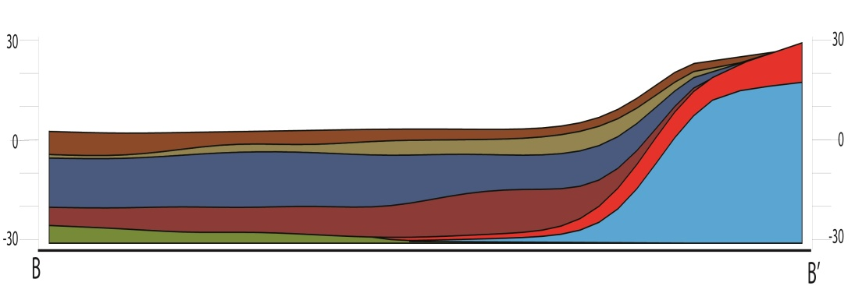
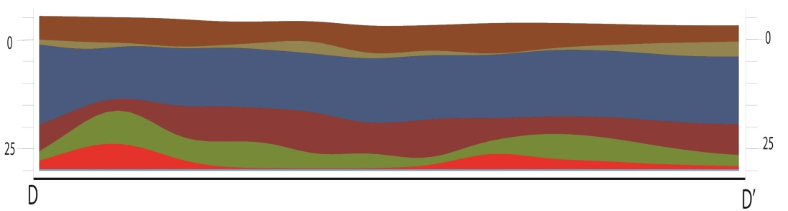
Subsurface lithological Cross-section

Slide 16
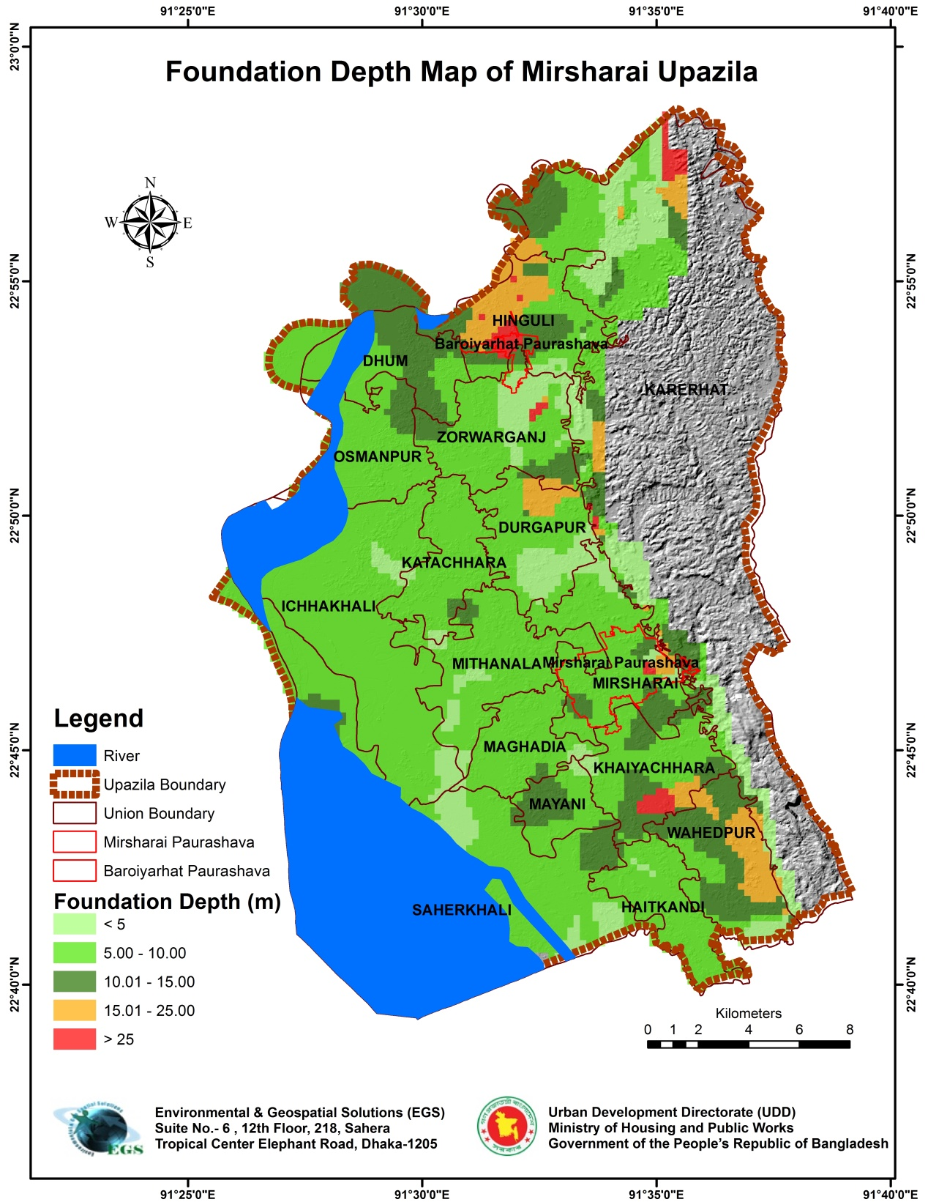

Slide 17
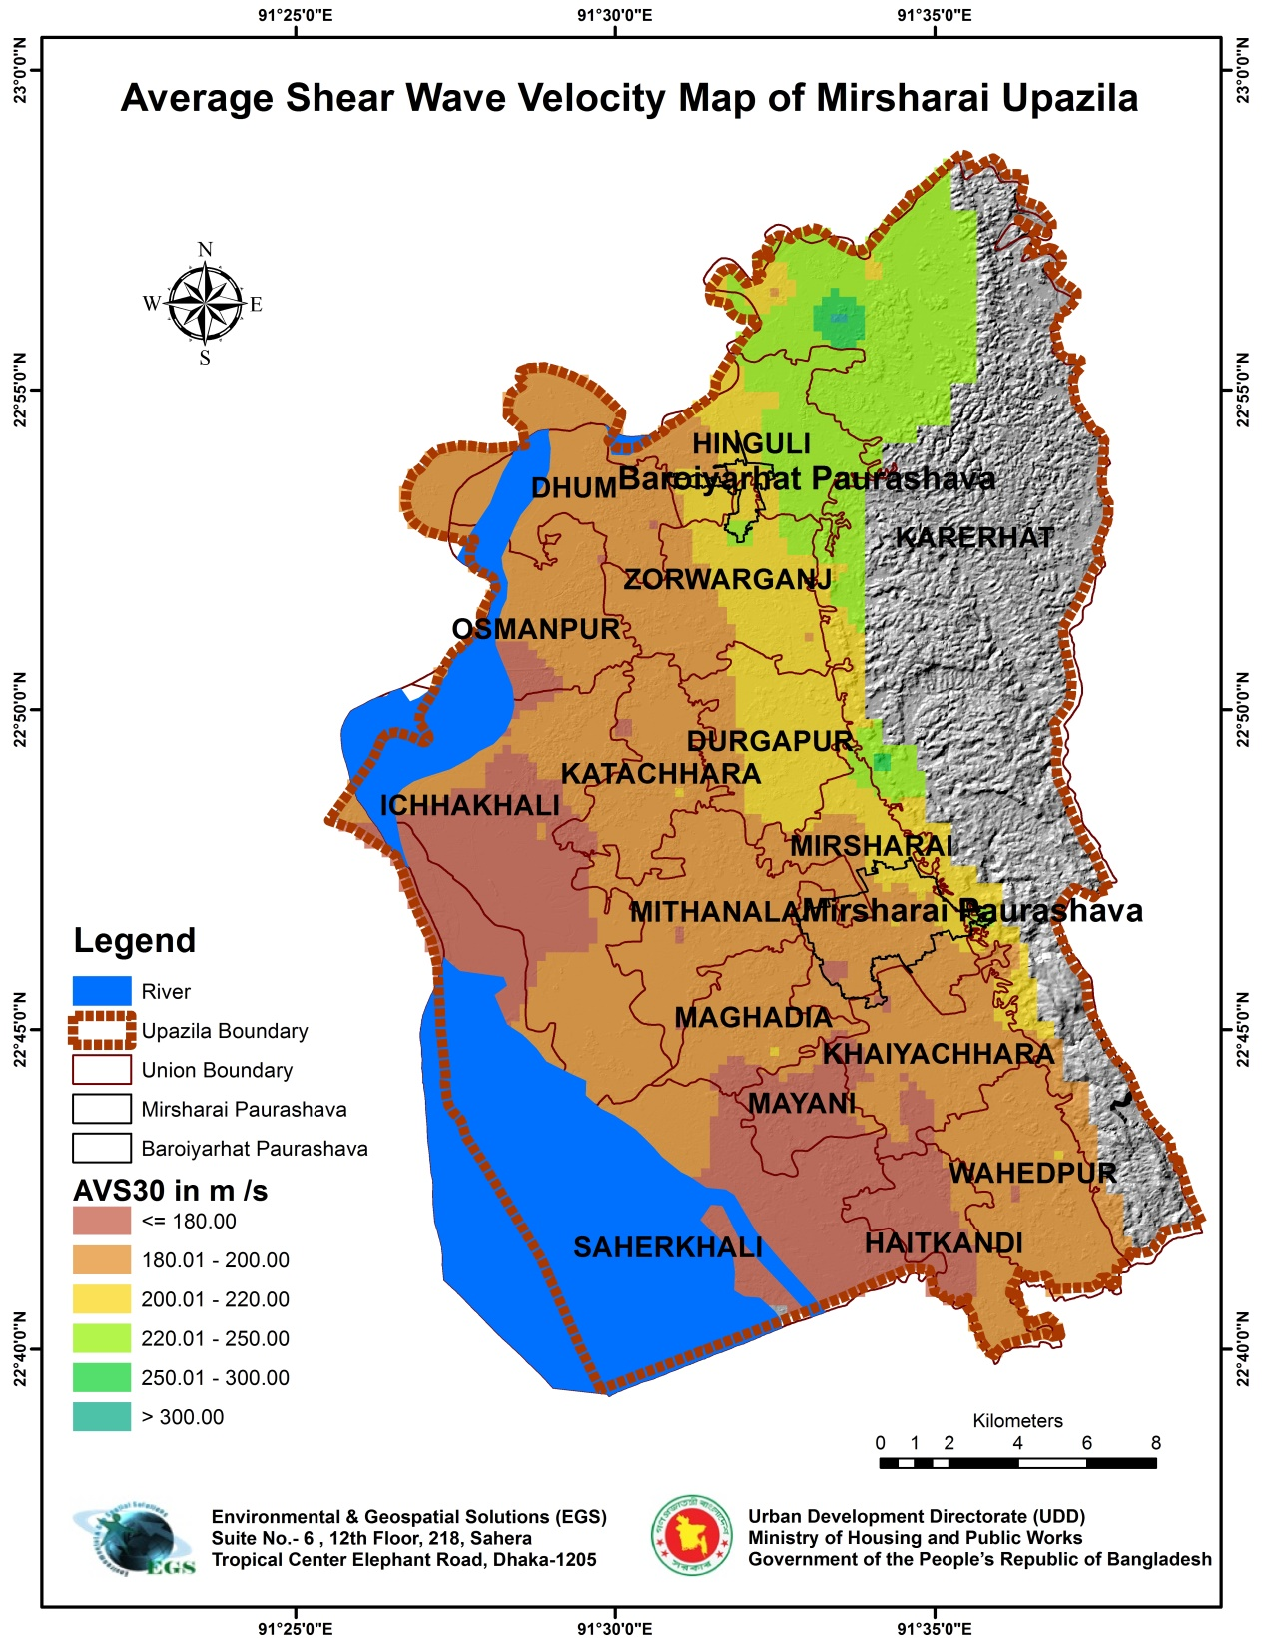

Slide 18
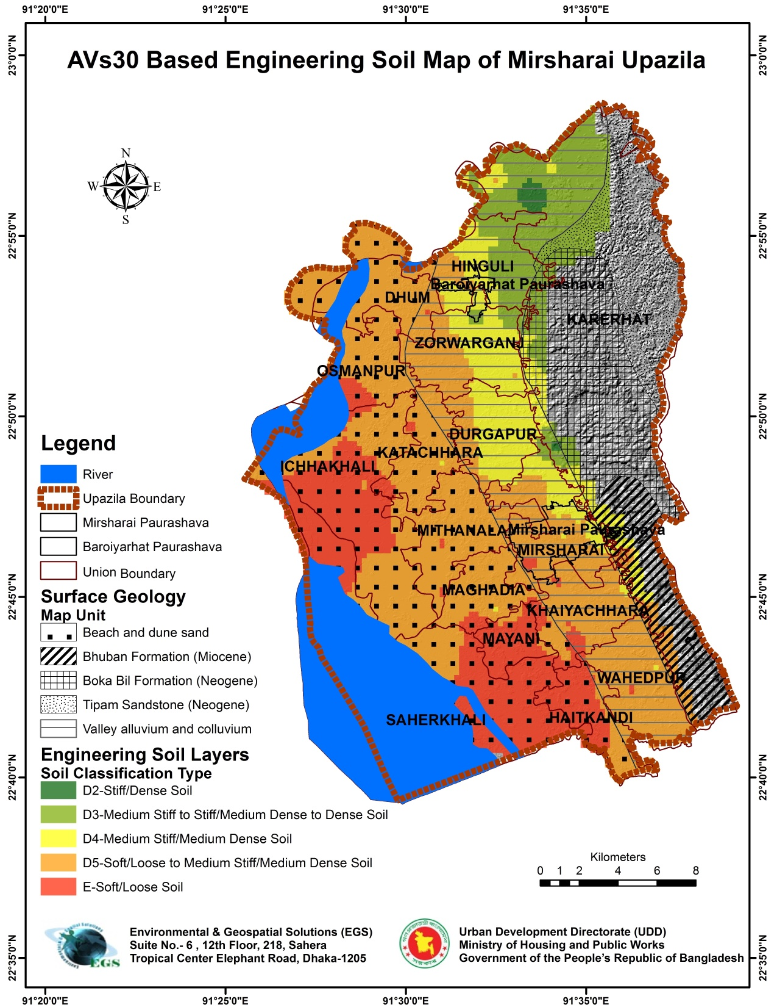

Slide 19
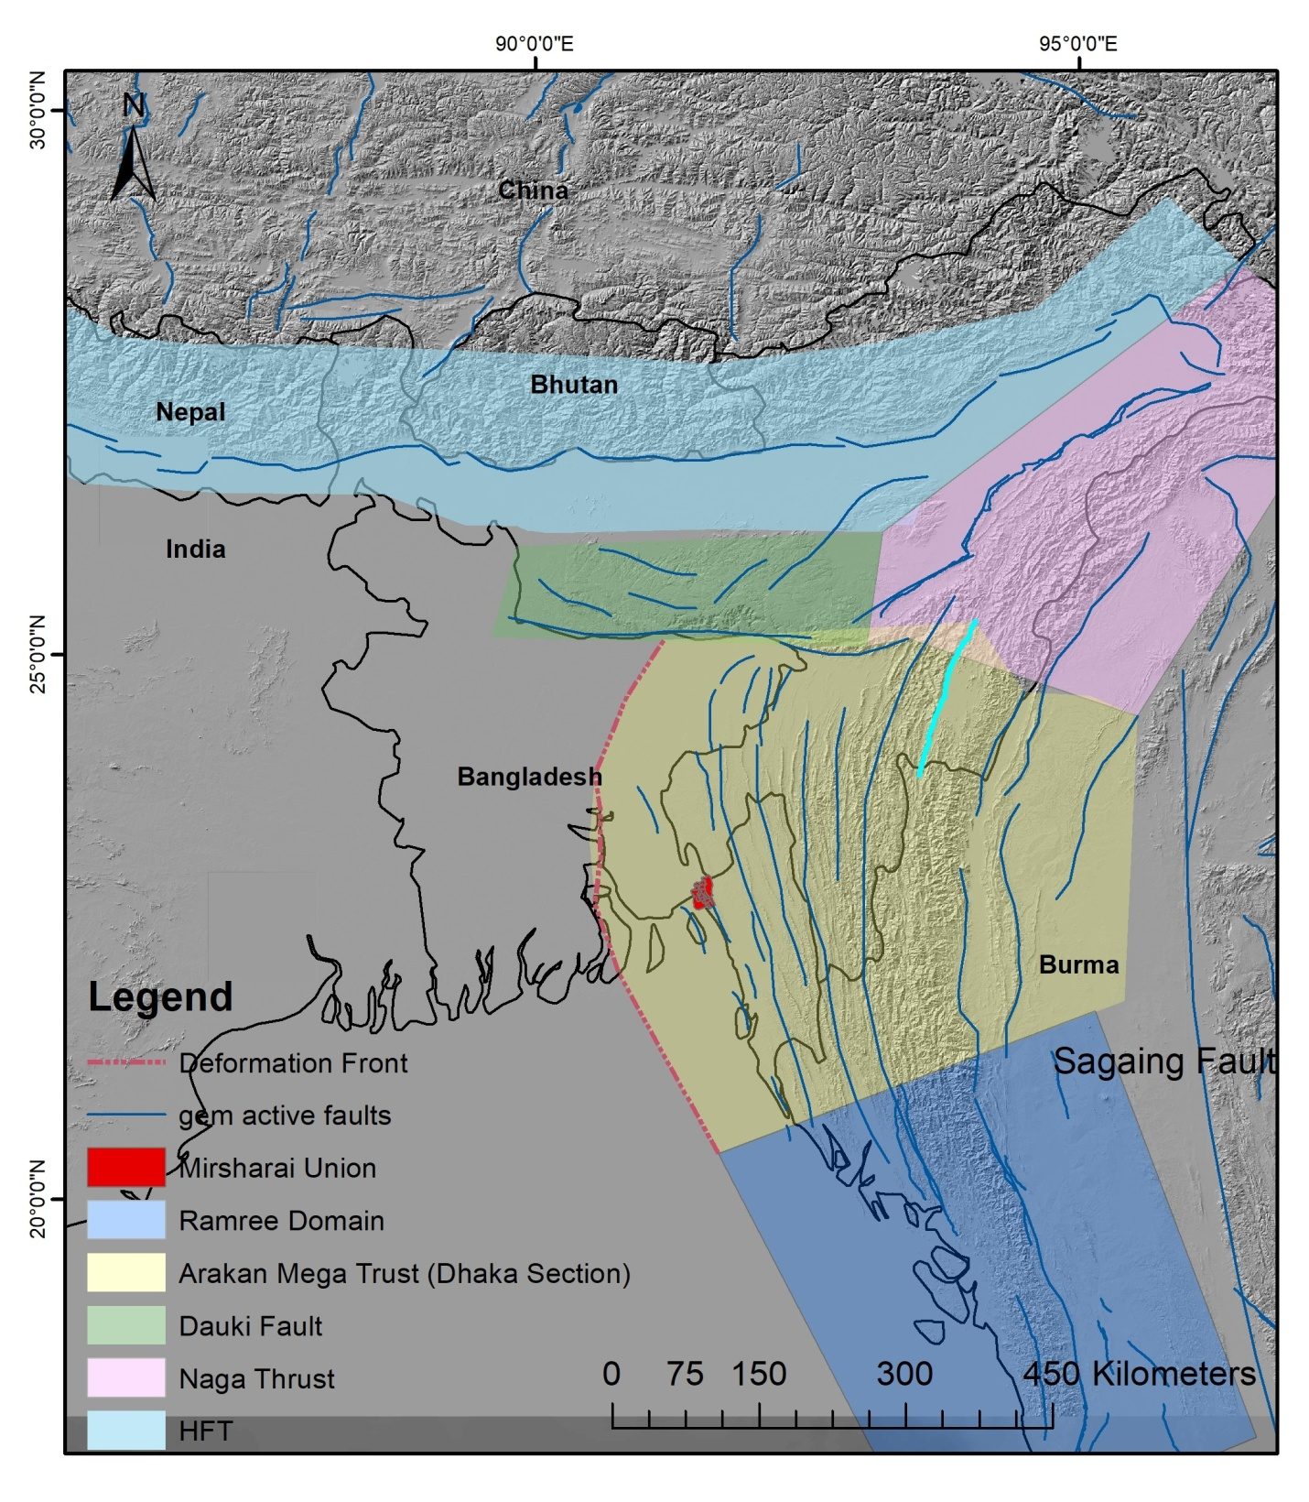
PROBABILISTIC SEISMIC HAZARD ASSESSMENT
Adopted from Wang (2014)

Slide 20
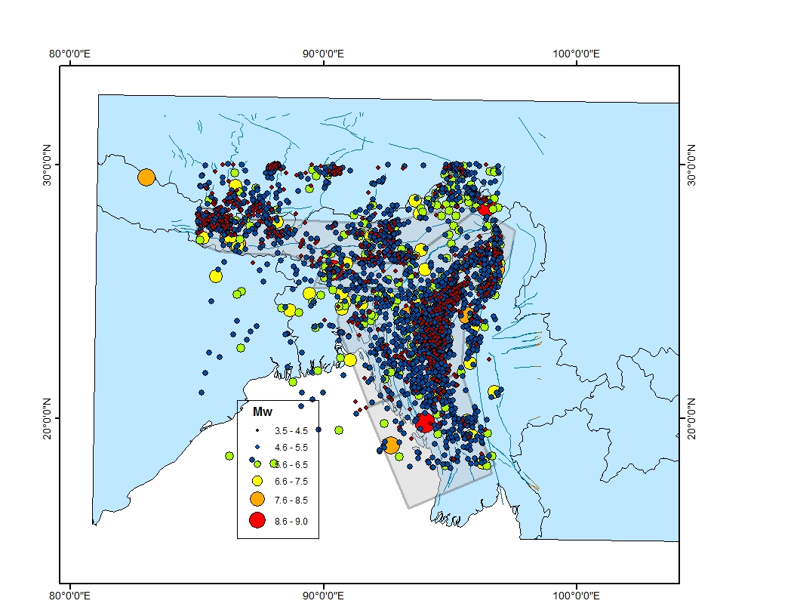
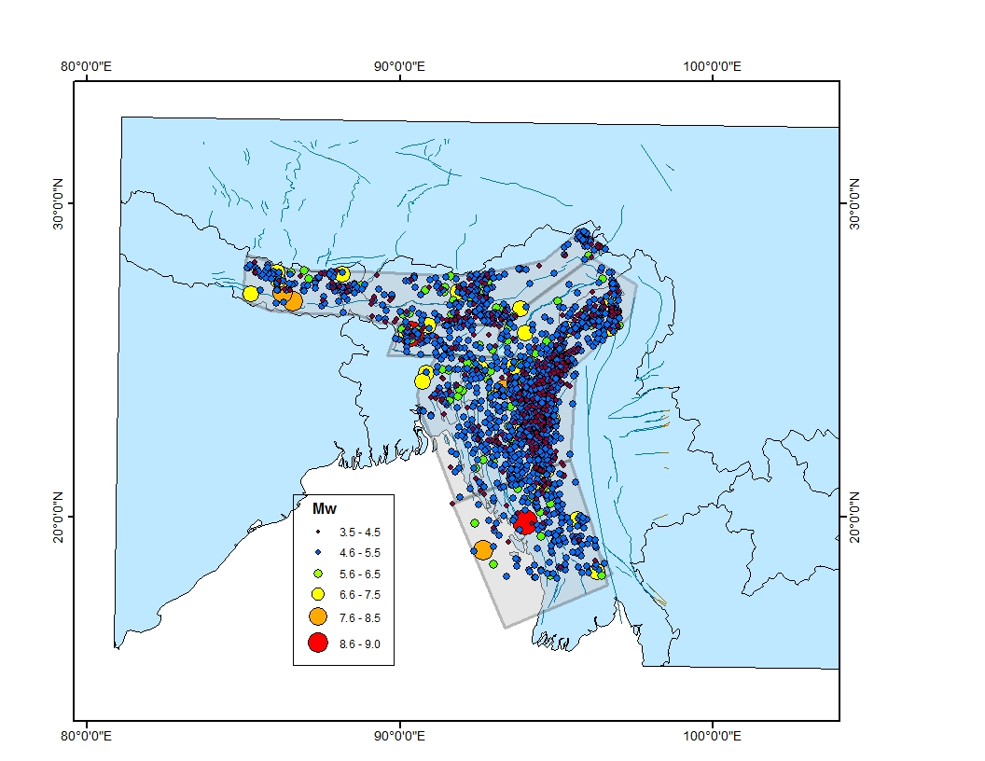
Declustering
Gardener and Knopoff | Before Declustering | After Declustering
 | 3296 | 1936

Slide 21
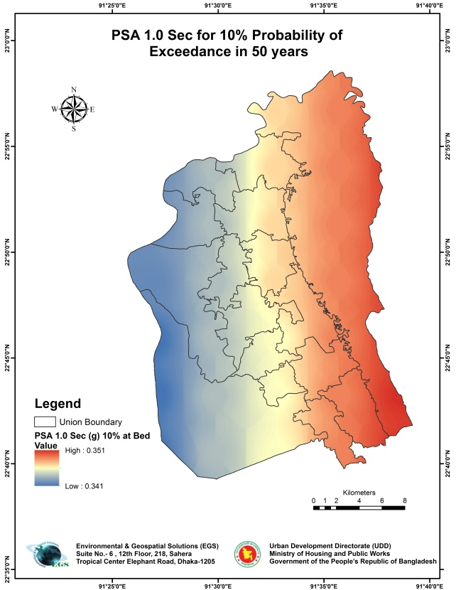
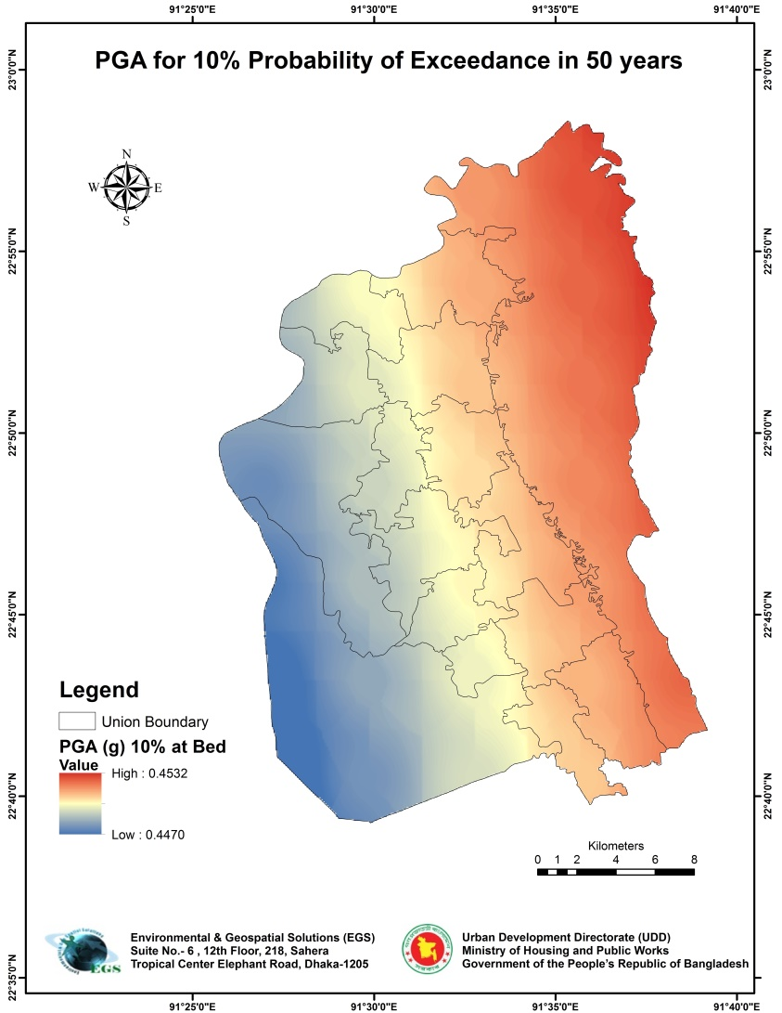
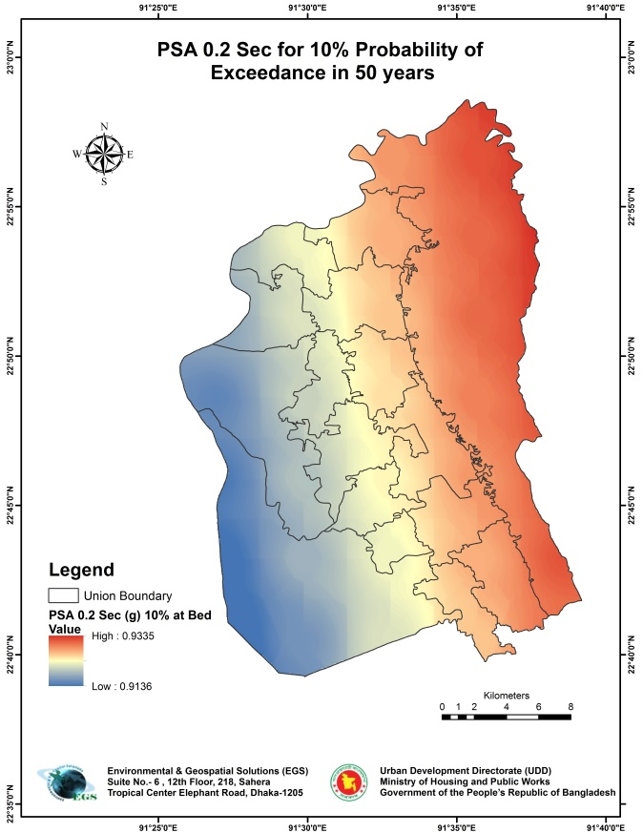
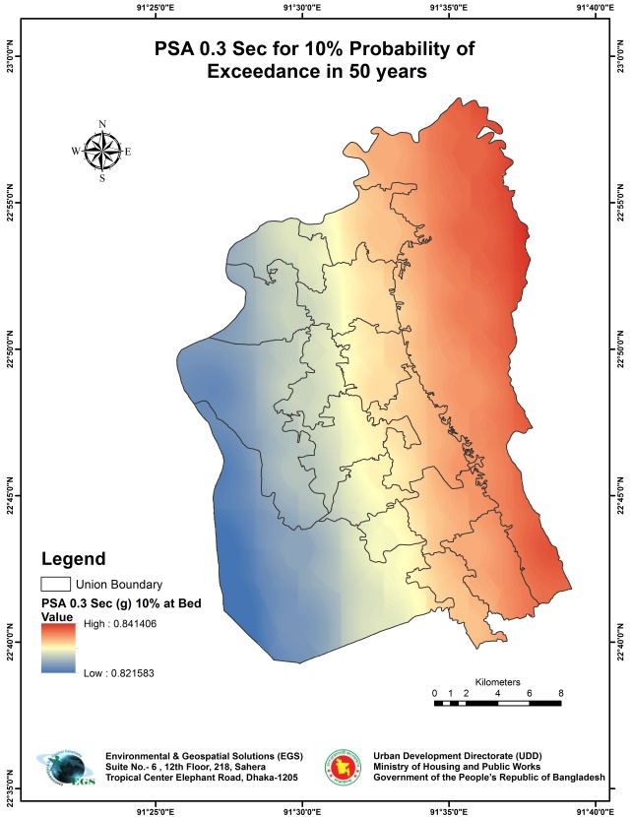
Without Site Effects/At Bed

Slide 22
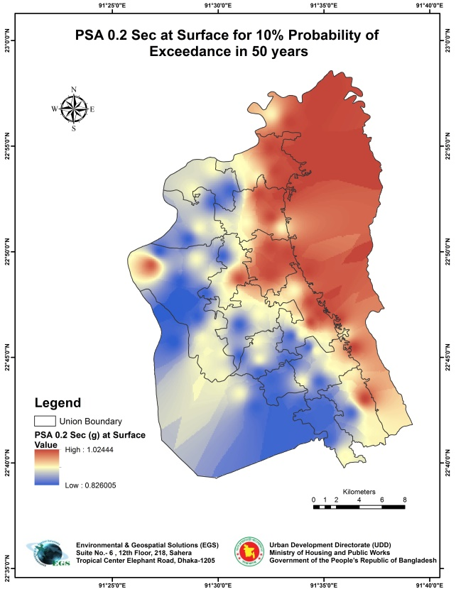
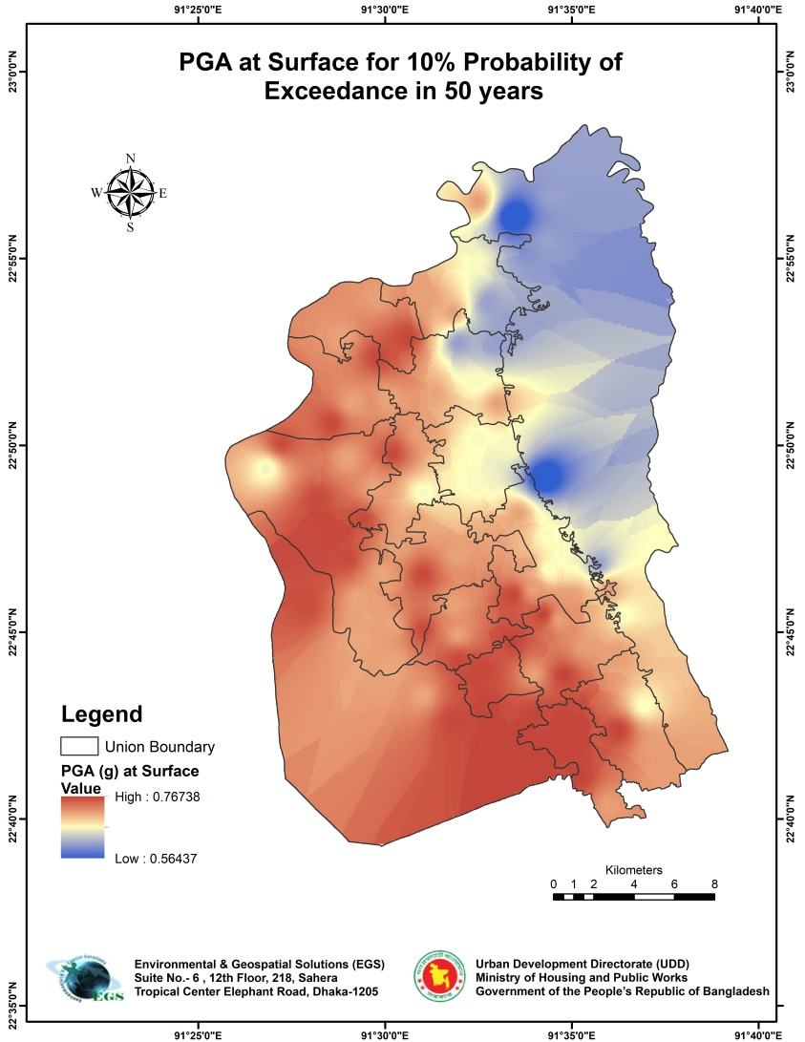
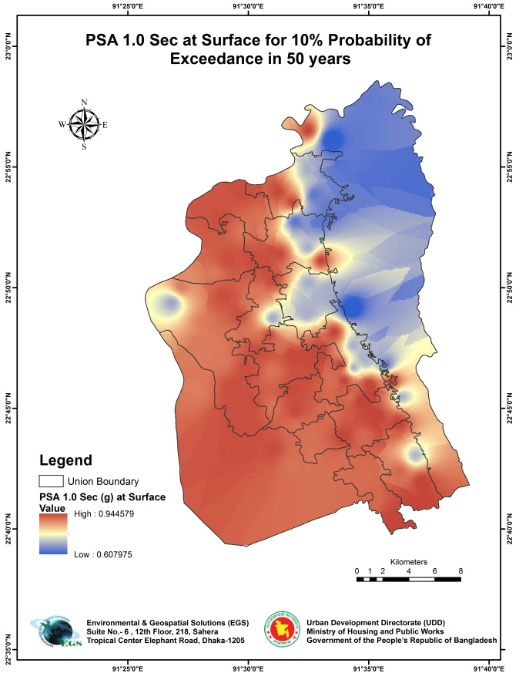
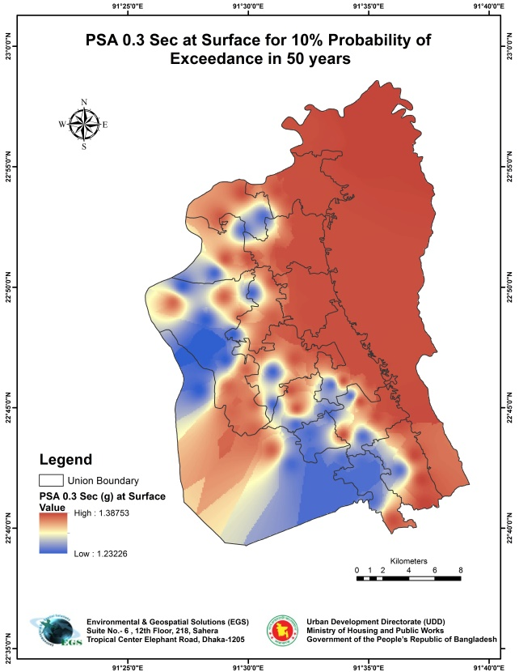
With Site Effects/At Surface

Slide 23
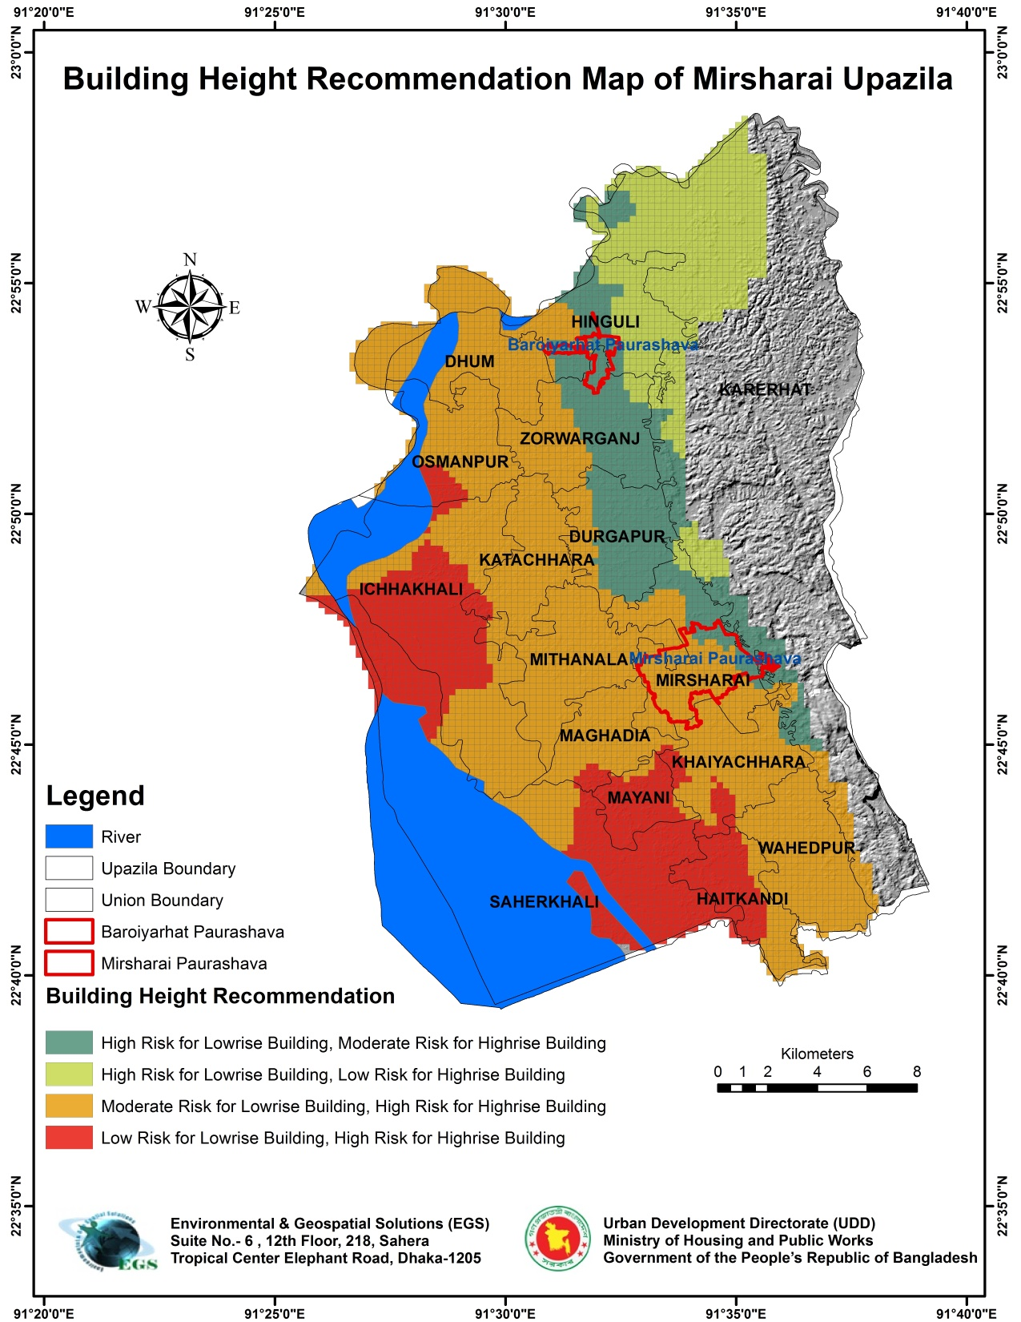

Slide 24
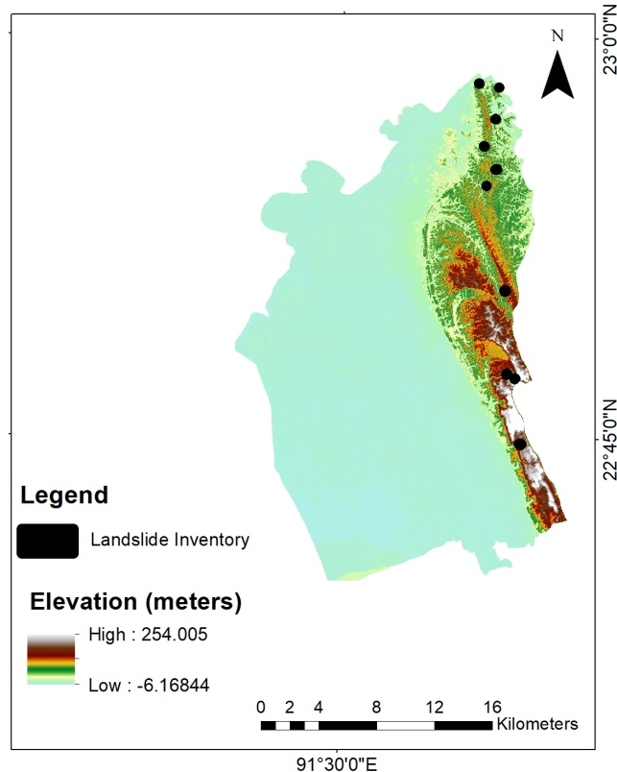
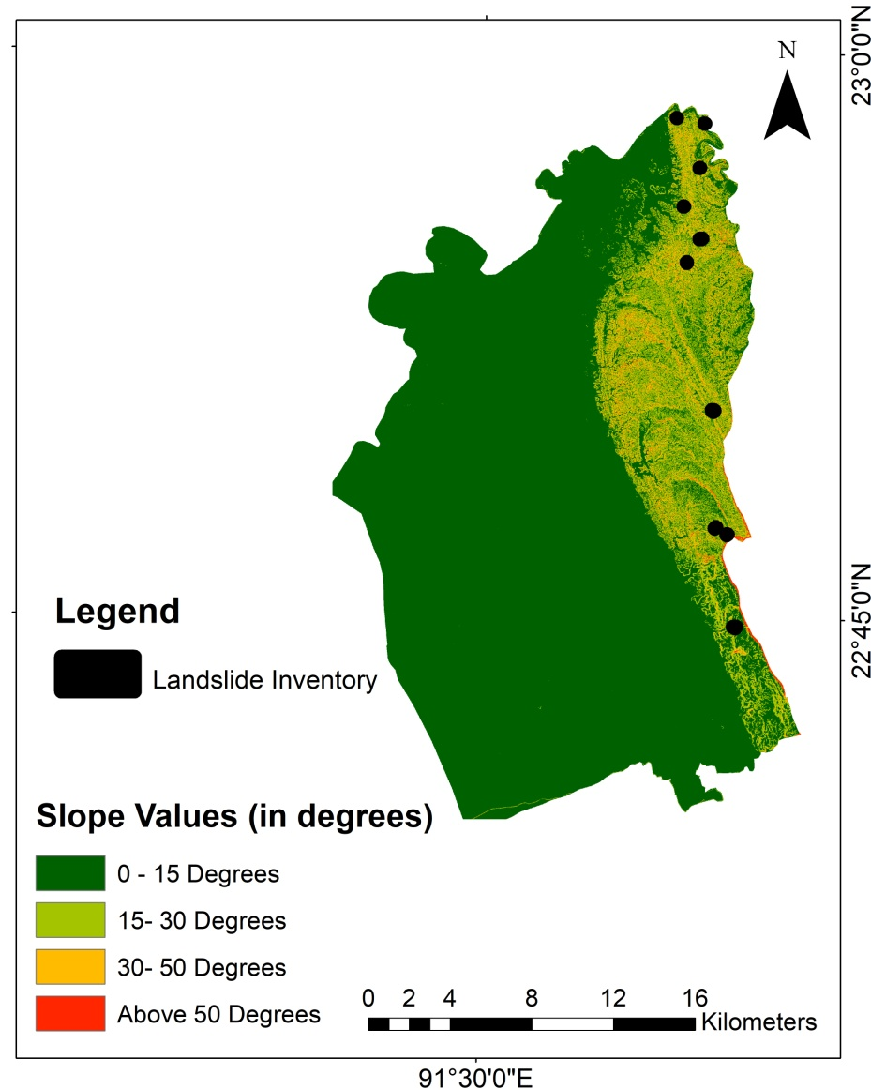
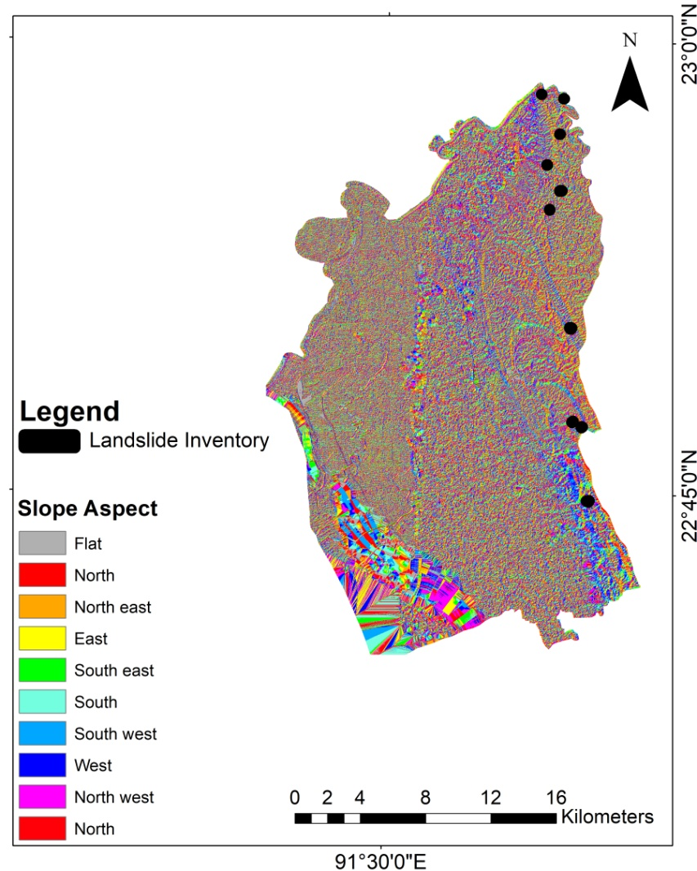
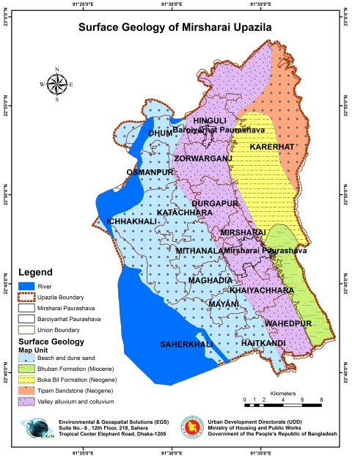
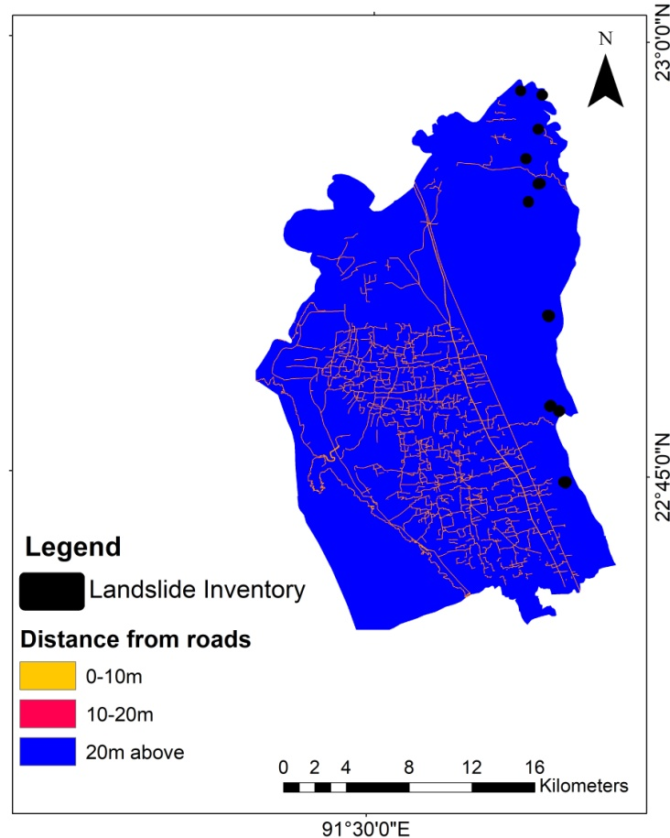
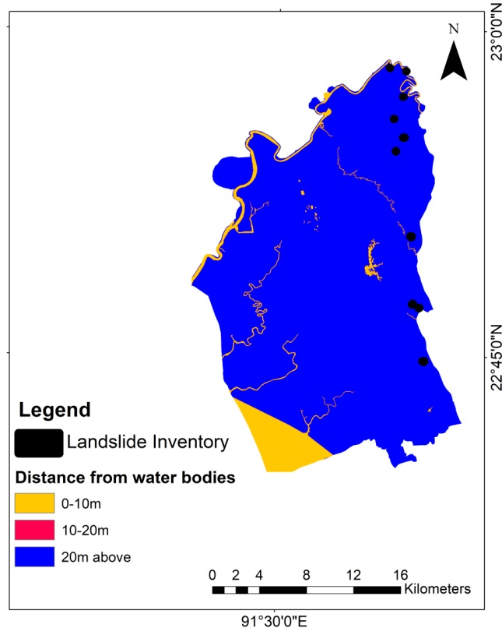
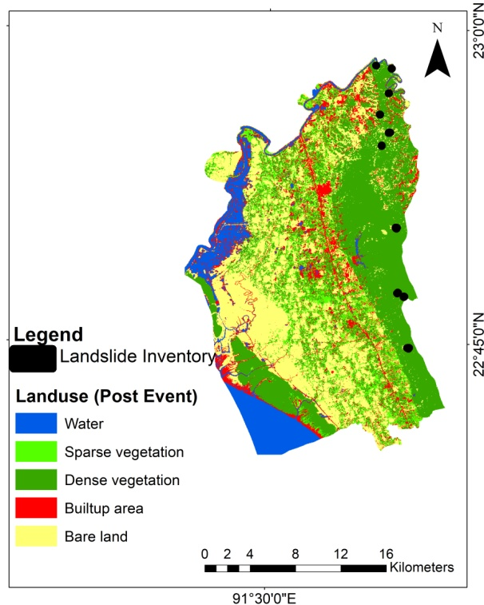


Landslide Susceptibility Assessment
Triggering Factor Maps
Elevation
Slope
Aspect Surface Geology
Distance from Streams
Road Distance
Landuse and NDVI Difference
Rainfall

Slide 25

SUSCEPTIBLE CLASSES | PERCENTAGE (%)
Very low | 77
Low | 8
Moderate | 13
High | 2

Slide 26

Liquefaction Potential Index
Triggering Factor
PGA
Mw
N-value
Water Table
And Grain Size
Seed, H.B., Idriss, I.M., 1971;1982
Iwasaki, T., Tokida, K., Tatsuoka, F., Watanabe, S., Yasuda, S., Sato, H., 1982

Slide 27



Slide 28


All Information at 250m * 250m Grid

Slide 29
THANK YOU ALL

